Slide 1


Slide 2

Presentation on
Magnification
by
Baddala Bhavya Sree
10th - A section
Under the guidance of
Dr. B.N Swetha
HOD of Physics Department

Slide 3

Magnification:
Magnification (M) is the ratio of the height (or size) of the image to the height (or size) of the object.
The magnification is generally represented by the letter M.

Slide 4
Formula
1
Height-Based
2
Distance-Based
m = h' / h where h' is image height and h is object height.
m = v / u where v is image distance and u is object distance.
Both formulas help calculate magnification using different parameters.

Slide 5
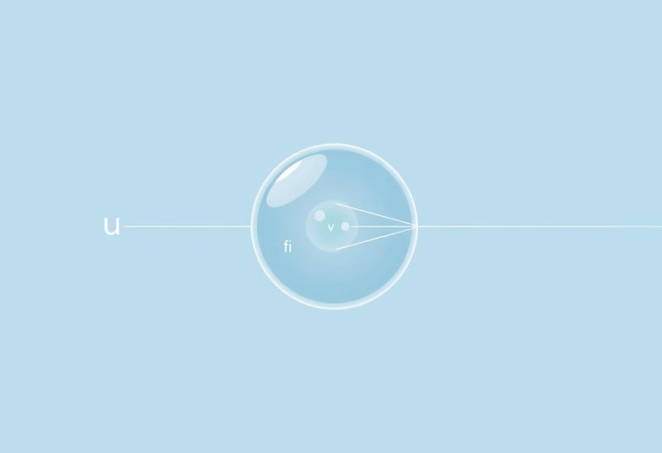
Lens Formula
The lens formula shows the relationship between key distances.
These distances are object distance (u), image distance (v), and focal length (f).
The formula is:
1/v - 1/u = 1/f
It helps to calculate image or object distance for lenses.

Slide 6
Lens Formula Example
Problem Statement
Solution:
A concave lens has a focal length of 15 cm. At what distance should the object be placed so that it forms an image 10 cm from the lens? Also, find the magnification produced by the lens.
We know:
Image distance, 𝑣 = −10 cm
Focal length, 𝑓 = −15 cm
Answer
We want to find: Object distance, 𝑢
Object distance: 30 cm (in front of the lens)
Using the Lens Formula: 1/𝑣 − 1/𝑢 = 1/𝑓
Magnification: 1/3 (image is diminished)
So: 1/𝑢 = 1/𝑣 − 1/𝑓
Using the lens formula and given values, the object distance is found to be 30 cm. The magnification is 1/3, indicating a diminished image.
1/𝑢 = (−1/10) − (−1/15) = −1/10 + 1/15
1/𝑢 = −3 + 2/30 = −1/30
Therefore, 𝑢 = −30 cm
To find the magnification (m), we use the formula: m = v/u. Given v = -10 cm and u = -30 cm, we get m = 1/3.

Slide 7
Lens Formula Example
Problem Statement
Solution:
A 2.0 cm tall object is placed perpendicular to a convex lens. The focal length is 10 cm.The object distance is 15 cm. Find the image's nature, position, size, and magnification.
Let's break it down:
Object height, ℎ = 2.0 cm
Object distance, 𝑢 = − 15 cm (Remember: object on left)
Answer
Focal length, 𝑓 = + 10 cm (Convex lens)
Using the lens formula, image distance is +30 cm.
Image distance, 𝑣 = ?
Magnification is -2.
Time for the Lens Formula: 1/𝑣 − 1/𝑢 = 1/𝑓
Image height is -4.0 cm.
So, 1/𝑣 = 1/𝑓 + 1/𝑢
Plugging in the values: 1/𝑣 = 1/10 + (-1/15) = (3-2)/30 = 1/30
Position: 30 cm on the other side of the lens
Nature: Real and inverted (since v > 0 , m < 0)
Therefore, 𝑣 = +30 cm
Size: Image height = 4.0 cm (twice the object, inverted)
Magnification: 𝑚 = 𝑣/𝑢 = 30/-15 = -2
Magnification: -2
Image Height = 𝑚 × ℎ = -2 × 2.0 = -4.0 cm

Slide 8


